Slide 1
Positive Behaviour Supports
Consequences cont’d

Slide 2

Ignoring
Can be effective
Maintains positive teacher-student relationships based on respect rather than fear
Requires educators give attention for positive behaviours as opposed to the negative ones

Slide 3

Ignoring
Can be powerful tool for changing behaviour since access to attention is a positive thing for students
Hard to carry out as educators have a tendency to attend to students who are being disruptive

Slide 4

Ignoring
Behaviour will escalate or intensify before it stops
Following through and consistency are key to being effective
Give positive attention to the student whenever you see appropriate behaviour

Slide 5

Redirecting
Gives students opportunities to become involved in more productive activities or appropriate behaviours
Should not be confrontational

Slide 6

Redirecting
Can be nonverbal, verbal or physical in nature (tap on shoulder, clapping, singing, picture cues, verbal reminders to class or individual students)

Slide 7
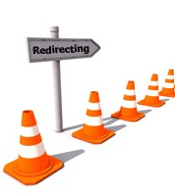
Effective redirection
Use with behaviours like: off task, inattentive, goofing around, talking out of turn, getting off topic, when students appear confused or doing a task incorrectly
Give a quick, succinct reminder or what they should be doing

Slide 8
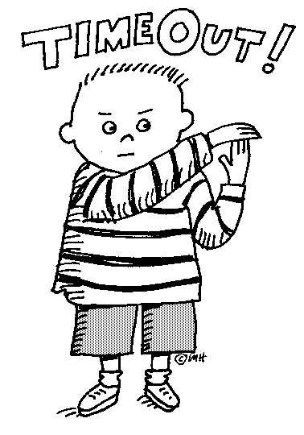
Timeout
By definition a punisher as it is intended to decrease behaviour
Can be reinforcing to avoid / escape behaviours
Usually doesn’t result in long term change as not educative in nature
Often done out of frustration

Slide 9
Timeout
If used should be part of the plan and follow all ethical procedures
If used should follow appropriate procedures for physical and emotional factors
If a regular response, then needs to be examined or plan revised
If used, document (frequency, time, who implemented, description of the incident, where, etc)

Slide 10

Article: Cracking the Behavior Code

